Slide 1
A Machine Learning Approach to Predict Crime in Dhaka
Prepared by
S. M. Imrul Kayes Shuva
Farhana Kabir

Slide 2
Abstract
Plenty of crimes occurring in every second all over the world
Bangladesh is a densely populated country
Recognizing the crime pattern is paramount
Supervised classification problem
Different classification models
Dataset collected from Mirpur Police Station

Slide 3
Problem Statement
Crimes are conducted frequently in Dhaka
Law enforcement agencies are helpless in many occasions
Lack of precautionary activities
Nothing to do?!

Slide 4
Introduction
A small statistics (Murder 216, Robbery 83, Women and Child Repression 1782, Theft 1290, Narcotics 16215, and many more only in Dhaka in 2018. Total Cases under DMP - 27150)
Criminal activities are affecting quality of life and socio-economical development
Machine learning agent can learn and analyze the pattern of a criminal activity
Decision Tree, Logistic Regression, Random Forest etc.

Slide 5
Literature Review
In USA, Decision Tree and Naive Bayesian algorithm on two datasets (1990 US LEMAS and crime data 1995 FBI UCR ), 83.95% accuracy (imbalanced classes?)
Somayeh Et Al - k-Nearest Neighbor - Chi-square feature, 89.50% accuracy
Other factors have been considered (unemployment, income level, education) as well in different papers.

Slide 6
We hope to find answers
Does a criminal database with basic info. has enough indicators to predict a crime?
How do the supervised classifiers perform?
Is there any other technique to improve the result?

Slide 7
Data Sources
Dhaka Metropolitan Police
Mirpur Model Police Station
Newspapers and online
Survey and 3rd party sources

Slide 8
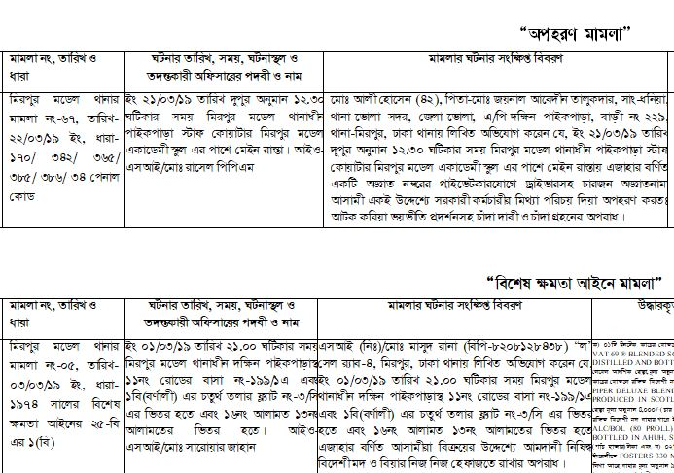
Idea about raw dataset

Slide 9

Methodology
Gaussian Naive Bayes
Decision Tree
Data Processing
K- nearest neighbor
Balanced?
Yes
Perform methods
Ensemble methods
No
Logistic Regression
Reduce Class Numbers
Good Accuracy?
No
Yes
No
Is data sampling completed?
Perform Oversampling
and Under-sampling
Halt
Yes

Slide 10
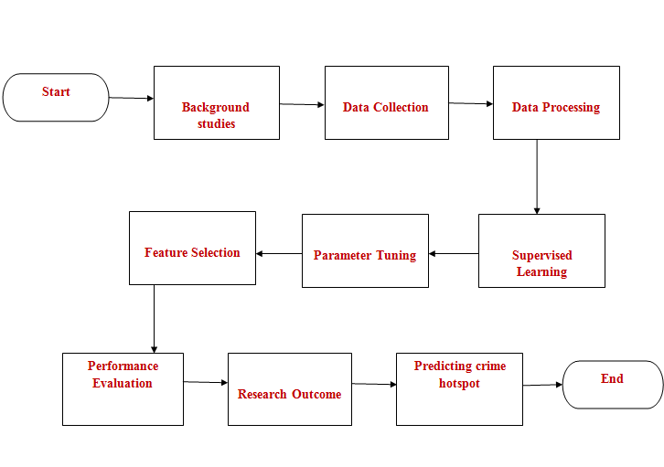
Workflow
Collecting Dataset
Data Cleaning and Pre-processing
Minimize Outcome Classes
Splitting Data
Performance Metrices
Results

Slide 11
Data Analysis
Crime Type | Total number
Drug | 125
Kidnap | 120
Theft | 165
Assault | 20
Suspicious | 15
Special Act | 32
Women and Child Abuse | 210
Robbery | 23
Fraud | 17
Non- Criminal | 10
Others | 74

Slide 12
Feature Selection
Time | Date | Location | Crime Type
7.13 | 11 March 2017 | 10 Circle | Assault
15.32 | 18 July 2017 | Rup Nagar | Theft
23.18 | 7 January 2018 | Tolarbag | Special Act
1.07 | 23 March 2018 | Mirpur 11 | Woman Repression
12.05 | 8 April | Shewra Para | Child Repression

Slide 13
Performance Evaluation
Algorithm Name | Accuracy
Decision Tree | 38%
Logistic Regression | 21%
Gaussian Naïve Bayes | 15%
K Nearest Neighbor | 28%
Random Forest | 36%
Adaboost | 11%

Slide 14
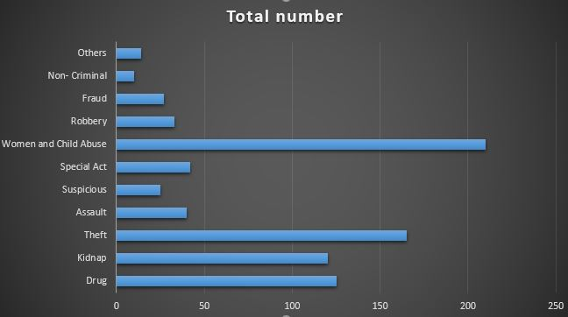
Imbalanced Dataset

Slide 15
Changing Approaches
We have divided a day into following parts:
● Morning: 6.00 AM-2.59PM = 1
● Afternoon: 3PM-10.59PM = 2
● Night 11.00PM-5.59AM = 3
Dates are also divided into 3 sections:
1 to 10th of a month is considered as 1
11 to 20th = 2
21 to 30th = 3 and will be continued.

Slide 16
What other factors can influence crime?
Crime Status
Education Level
Unemployment Rate
Any other enhancement in the dataset?

Slide 17
Performance Check
Algorithm | Accuracy on Train Data | Accuracy on Test Data
Decision Tree Classifier | 68.84% | 49%
Gaussian Naive Bayes | 29.02% | 24%
K-Nearest Neighbor | 60.40% | 39%
Logistic Regression | 49.02% | 36%
Random Forest Classifier | 70.62% | 54%
Adaboost Classifier | 24.16% | 26%

Slide 18
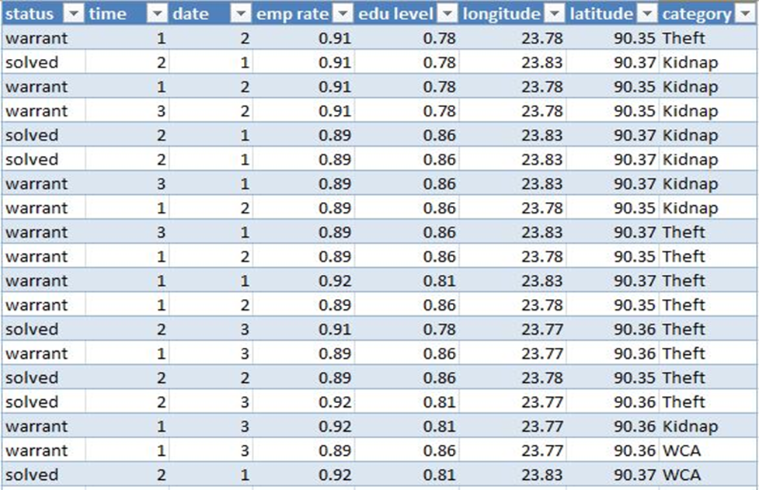
Final Approaches
Final Dataset

Slide 19
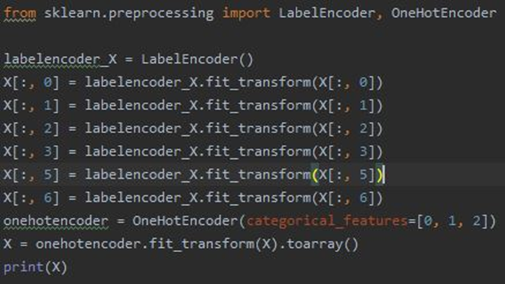
Implementation Phase
Label Encoder & One Hot Encoder

Slide 20
Feature Scaling
To bring all the features in a specific range, we used feature scaling which was not applied previously.
import pandas as pd from sklearn.preprocessing import StandardScalerdataset = pd.read_csv(cd.csv') X = dataset.iloc[:, [0,1,2,3,4,5,6 ]].values sc = StandardScaler() X = sc.fit_transform(X)

Slide 21
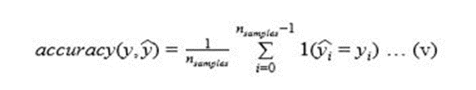
Result Analysis
Performance Matrices
Accuracy
F1_Score
K- fold Cross Validation
F1 Score = 2*(Recall * Precision) / (Recall + Precision)

Slide 22
Final Performance

Slide 23
Timeline
Initialization: We collected a bunch of dataset from Mirpur Model Police Station and some other sources in mid September with the cooperation of DMP
Analyze and Development: Then we have analyzed and processed the data, and started implementing by 1st week of October and finished around 10 November
Testing and Enhancement: Later on, we started testing and added some additional features by mid November
Closing: Hopefully, today we can show the implemented code of our thesis work.

Slide 24
Findings
Socio-economic standard - A key indicator of possible criminal activity
Deep Learning & Neural Networks could provide a more balanced understanding
Imbalanced classes – A major concern
Advanced techniques are remain to be explored

Slide 25
Conclusion
Bangladesh Perspective
Study of Criminology
A better world

Slide 26
References
Iqbal, R., Murad, M. A. A., Mustapha, A., Panahy, P. H. S., & Khanahmadliravi, N.(2013). An experimental study of classification algorithms for crime prediction. Indian Journal of Science and Technology ​ , ​6 ​ (3), 4219-4225.
Shojaee, S., Mustapha, A., Sidi, F., & Jabar, M. A. (2013). A study on classification learning algorithms to predict crime status. ​International Journal of Digital Content Technology and its Applications ​ , ​7 ​ (9), 361.
Adel, H., Salheen, M., and Mahmoud, R. (2016). "Crime in relation to urban design. Case study: the greater Cairo region". Ain Shams Eng. J. 7(3): 925-938.
Alves, G. A. L., Ribeiro, V., H. and Rodrigues, A. F. (2018). "Crime prediction through urban metrics and statistical learning," Physica A, vol. 505, pp. 435-443.
Crime Data 2018, Dhaka Metropolitan Police, viewed 23 September 2019, <http://dmp.gov.bd/crime_data_year/2018/>.

